Slide 1
Notes:
Introduction
Bio
My name is Richard Tasker. You can find me on twitter [at]ritasker. I also occasionally blog at richardtasker.co.uk.
I am predominantly a .Net developer, but I can also be found coding in JS, Ruby and Python.
For the past year I have been working with the Azure platform for a small Leeds startup.
The Talk
Today I am going to talk about what services Azure provides to help you host your Web Application on the platform.
As Azure is such a massive platform I unfortunately can’t go into great detail, as I have only got an hour. But if you have questions don’t be afraid to ask I will do my best to answer, or you can email me.

Slide 2
Why use
Cloud Computing?
Notes:
Why use Cloud Computing?
If you have an on-premises data canter you have to deal with the purchasing and installation of the hardware, the installation of operating systems and any other software required. Then there is the setup of the networks, configuring of firewalls, etc.
Once the servers are setup they need to be maintained.
Finally you need to predicted what your average load will be and buy extra hardware for when you have high load. Which wont be doing anything most of the time, other than costing you money.
With cloud computing the vender is responsible for the servers. They will purchase servers, update and upgrade them for you. The only thing you have to pay for is the amount of servers or VMs you use.

Slide 3


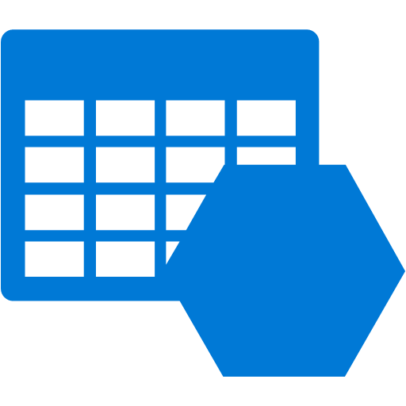



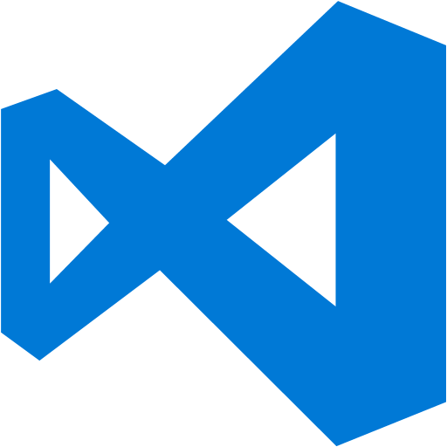
What is Azure
Notes:
What is Azure
Azure is Microsoft’s entrant to the Cloud computing market.
Microsoft provide a lot of services via the Azure platform, each of the services will fall into either the Infrastructure-as-a-Service (IaaS) or the Platform-as-a-Service (PaaS) categories.
With IaaS you get access to virtualised hardware, such as virtual servers, load balancers, VPNs, mail servers, Identity servers, etc.
PaaS gives you access to managed services and software. You don’t have to worry about patching servers or upgrading the software this is done for you.
All of the services I will talk about today come under the PaaS category.

Slide 4
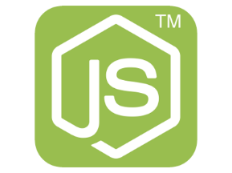
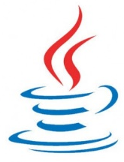

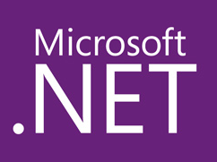
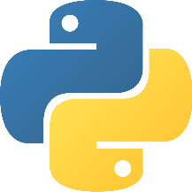
Hosting your App
Notes:
You may have an existing application which you want to move to Azure or you may be starting a new project and you are looking to host on Azure.
You will be able to host applications written in .Net, NodeJS, PHP, Python and Java.
Azure gives you two hosting options,
WebApps, which is part of the App Services, which include Mobile Apps, API Apps and Logic Apps.
Developing a WebApp should feel very familiar to you as you don’t have to do anything vastly different when developing you app. WebApps are designed to get you up and running as quick as possible, configuration is simple and deployment is fast.
WebRole sare the other option, which are part of Cloud Services. Cloud Services also includes Worker Roles which I’ll touch on later. WebRoles are designed for highly scalable apps that are reliable and cheap to run. WebRoles are a lot more configurable than WebRoles and also give you more control over the VM.

Slide 5
Azure WebApps
Notes:
Azure WebApps is a fully managed platform that enables you to rapidly build and deploy web apps by abstracting away and simplifying any configuration and infrastructure concerns.
Marketplace - WebApps allow you to install open-source frameworks and site templates such as Wordpress, Umbraco and Joomla from the Azure Marketplace.
Scaling - Its is possible to scale your app by either manually selecting the number of server instances you need or by setting up auto-scale.
Continuous Deployment - It is very easy to setup a Continuous Deployment pipeline with WebApps, you can deploy using Webhooks from the likes of GitHub. By using WebDeploy from a build server like Teamcity or my preferred option via Octopus Deploy.
Deployment Slots - You can setup deployment slots with WebApps, you can deploy your app into a preproduction slot and when everyone is happy the app works, with one click of a button release the app.
A/B Testing - Because of these deployment slots it is possible to do A/B testing by diverting some traffic to the alternative site.

Slide 6
Azure Web Roles
Notes:
Web Roles are Web Apps on steroids.
Just like App Services are hosted on VMs, so too are Cloud Services, however, you have more control over the VMs. You can install your own software on Cloud Service VMs and you can remote into them.
More control means more complex, so unless you need the extra control I would just use a WebApp.
One of these complexities are startup tasks. You can use startup task to preform operations before the WebRole is started.
You are able to execute Command line scripts and programs even with raised permissions.
Common tasks include,
Configuring IIS
Adding Firewall rules
Installing additional software
As well as the startup tasks WebRoles has an Entry Point class which has event handlers which are executed at different times in the application lifecycle. There is an OnStart method, a Run method and an OnStop method.
OnStop – The OnStop method is executed before the application is started. You could use the method to check to see if tables or queues exist and create them if they don’t. Prime caches with data and so on.
Run – You probably wont use the Run method in a WebRole, but for a WorkerRole this is where you would put your WorkerRole logic.
OnStop – OnStop is executed when the app pool is recycled. And can be used to clear up your app before it starts again.
Scaling works slightly differently in WebRoles than in WebApps. You can still configure your app to autoscale or manually select the number of instances you require. But you can also set how many WebRoles instances to run on the VM. For example you could have three instances of you WebRole running on a VM instance and when the VM instance scales you will get three more WebRole instances on the new VM.
It is possible to programmatically scale out the WebRole instances. So you could max out the load on one VM by adding new WebRole instances before spawning a new VM instance

Slide 7
Web Apps vs Web Roles
WEB APPS
WEB ROLES
Fast to deploy
Fast provisioning & scaling
Install Marketplace apps
Config transforms on deploy
Remote debugging in VS
Use non standard HTTP ports
Can RDP into the VMs
Run start up scripts with elevated privileges
Full control of IIS
Two deploy slots by default
Deploy multiple web sites
Notes:
In conclusion, most of the time a web site will be the best choice. It is the simplest to setup and fastest to deploy. But if you need multiple sites that are massively scalable that require you to run some sort of start up process then maybe Web Roles are for you.
Any questions.

Slide 8
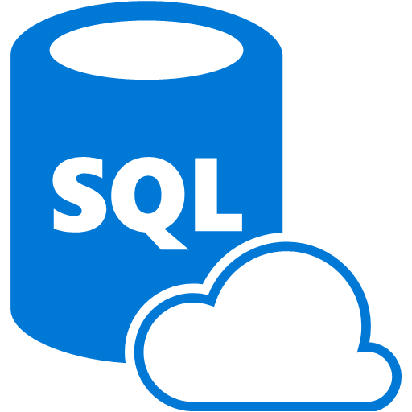
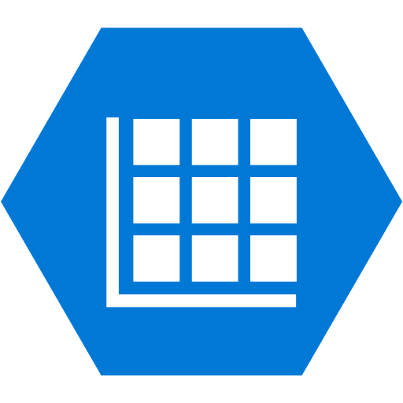

Data Storage
Notes:
Before you can start deploying your app, you will probably need to store some data.
Most people are so used to using relational data stores that they tend to forget there are other data store options available when architecting their app.
A good developer uses the right tool for the job, so lets have a look at what tools Azure provides.

Slide 9
Data Storage
Relational | Key/Value | Column Store | Document | Graph
SQL Server | Dynamo | Cassandra | MongoDB | Allegro
Oracle | Redis | Druid | RavenDB | Neo4j
MySQL | Riak | HBase | CouchDB | OrientDB
SQLite | Aerospike |  | RethinkDB | StarDog
Postgres
Notes:
Most data store technologies will fall into one of 5 families.
A lot of these data stores are already on Azure either through managed services or marketplace add-ins and many more are becoming available as the community builds containers for them.
There are three managed services on Azure that will cover most of your data storage use cases.
Azure SQL – A cut down version of Microsoft’s popular relational SQL Server.
Table Storage – A fast Key/Value data store
DocumetDB – I will give you one guess which family Document… DB is from.

Slide 10
Azure SQL
Notes:
If you have an on premise server with a vanilla install of the latest version of Windows Server, how long will it take to provision a SQL Server install?
It will probably take about 5mins to setup a brand new SQL instance with an empty database.
What the Azure team are doing here is providing a relational Database-as-a-Service. Because this is a managed service, it takes away all the maintenance and licensing costs.
And all that time spent setting up the SQL server.
Azure SQL provides predictable performance, scalability with no downtime, business continuity and data protection all with almost no administration. Which means you can focus on developing the features of your app using a familiar tool.
Because Azure SQL is built upon the SQL engine it means you can use existing SQL Server tools, libraries and APIs which makes it easier to move your app to the cloud.

Slide 11
Azure SQL
 | Basic | Standard | Premium
DTUs | 5 | 10-100 | 125-1000
Max DB Size | 2GB | 250GB | 500GB
Mx Concurrent Reqs | 30 | 60 - 200 | 200 - 1600
Mx Concurrent Logins | 30 | 60 - 200 | 200- 1600
Mx Sessions | 300 | 600 - 2400 | 2400 -19200
Transaction Rate | 16600/hr | 521 - 5100/min | 105 - 735/sec
Notes:
Azure SQL has three service tiers with different performance aspects.
Basic: Best suited for a small size database, typically used for development or testing, or small scale applications.
Standard: The go-to option for most cloud applications, supporting multiple concurrent queries. Examples include workgroup or web applications.
Premium: Designed for high transactional volume, supporting a large number of concurrent users and requiring the highest level of business continuity capabilities. Examples are databases supporting mission critical applications.
This table gives you some of the limits and governance for the different tiers.
The top DTUs (or Database Transaction Unit) row is a unit of measure that represents the relative power of the database. The metric is a combination of how much CPU, memory and the number of read/writes available to the database. With the resource allocated a basic database with 5 DTUs will be able to complete 5 transaction per second when fully loaded.
Each SQL server instance has 2000 DTUs and you can split that how you want. For example you could have 2 of the Premium databases at 1000 DTUs each or 400 basic databases or anything in between.
Because the databases are allocated a set amount of resource this is how Azure can predicted the performance of the database.

Slide 12
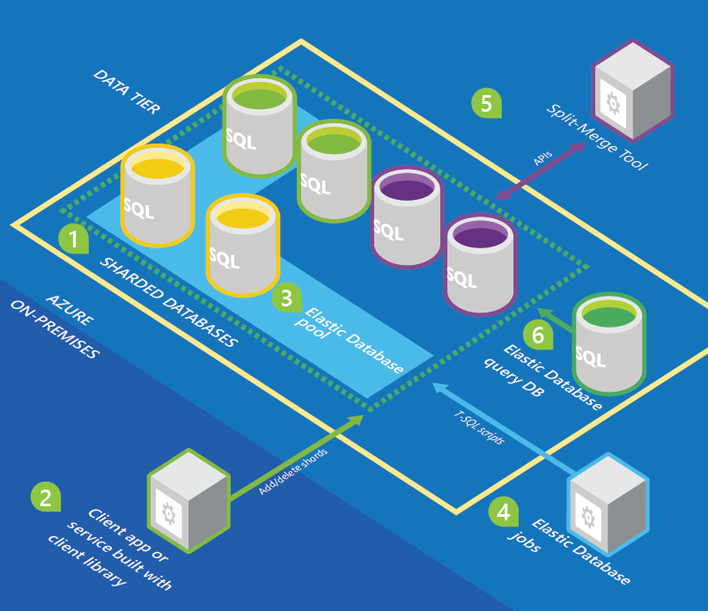
Azure SQL - Scale
https://azure.microsoft.com/en-us/documentation/articles/sql-database-elastic-scale-introduction
Notes:
Azure SQL should be very familiar to use as it is built upon the same database engine you are used to using.
There is one feature worth going into slightly more detail. Elastic Scale.
Elastic scale is a simple concept, you create a database pool and allocate a DTU performance value. Then by using the Elastic Database Tools and libraries and a few lines of code you will be able to easily create and manage database shards. You will be able to create as many shards as you need but will only be able to simultaneously interact with as many databases up to the DTU value you allocated to the pool.
A simple example would be to have a pool with 1000 DTUs allocated to it and then fill it with 800 basic databases shards. In code you would connect to the pool and query 200 of the databases at once.
Further reading - https://azure.microsoft.com/en-us/documentation/articles/sql-database-elastic-scale-introduction/

Slide 13
DocumentDB
Notes:
Azure DocumentDB is Azures offering in the document database family.
A document databases document is a collection of named fields and values. Where the values can be standard data types or complex objects and arrays. The documents can be encoded in a variety of ways, including BSON, JSON, XML and YAML.
DocumentDB is a fully managed JSON document database as a service and designed to keep pace with modern rapidly evolving applications.

Slide 14
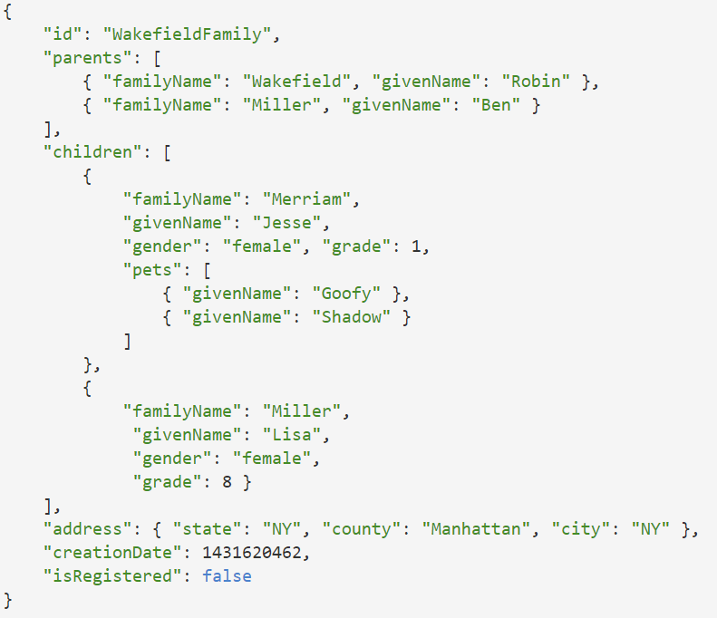
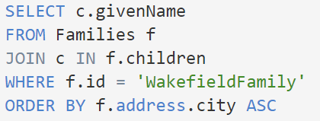
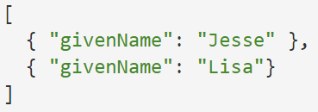
Querying Documents
Notes:
DocumentDB automatically indexes all JSON documents, then allows you to query them with a SQL like syntax.
Here is an example JSON document. And selecting the givenName from the childrens array will result in.

Slide 15
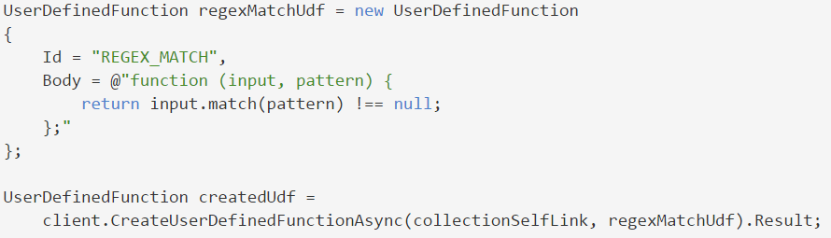

Querying Documents
Notes:
DocumentDB provides full transactional execution of JavaScript directly inside the database engine. Meaning you can write and execute stored procedures and user defined functions directly on the database written in Javascript.
In this example creates a UDF whose name is REGEX_MATCH. It accepts two JSON string values input and pattern and checks if the first matches the pattern specified in the second using JavaScript's string.match() function.
And here is how you would use the UDF in a query.

Slide 16
Azure Table Storage
Notes:
Azure Table Storage is a non-relational, key-value pair data store designed for storing massive amounts of unstructured data and optimised for fast retrieval.
Table storage offers highly available, massively scalable storage so you application can automatically scale to meet demand.

Slide 17
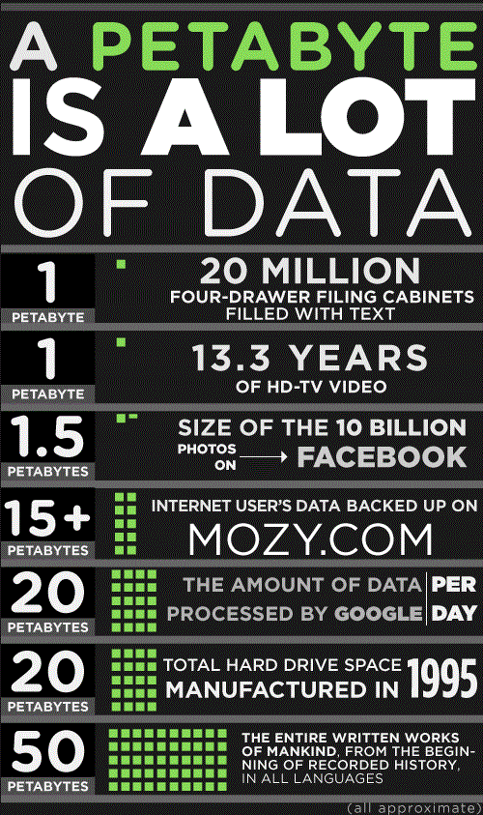
How Much Data!?
Locally redundant storage
Zone redundant storage
Geo-redundant storage
Read-Access Geo-Redundant Storage
http://mozy.com/blog/misc/how-much-is-a-petabyte/
Notes:
Table storage is scales in terms of data storage rather than server resource. With a single Azure subscription you can create 50 storage accounts and each storage account can store up to 500TB of data, that’s 25 peta bytes of data.
With those sort of volumes of data available you would be pretty miffed if that data was lost.
Azure always at least three copies of you data. When you create a storage account you have to pick one of 4 replication options.
Locally redundant storage – data is replicated 3x in a data centre.
Zone redundant storage – data is replicated 2-3 times within 1 or 2 near by regions.
Geo-redundant storage – data is replicated 6x. 3x in your primary region and 3x in a secondary region which is located hundreds of miles away.
Read-Access Geo-Redundant Storage – The same as Geo-Redundant Storage, but you get read access to the secondary location when the primary location is unavailable.

Slide 18
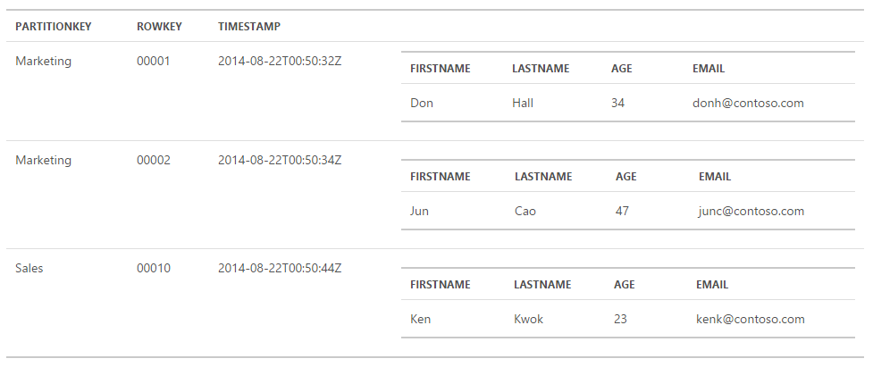
Designed For Speed
https://azure.microsoft.com/en-gb/documentation/articles/storage-table-design-guide/
Notes:
Table storage is designed to be fast at retrieving data. If you are used to developing relational models you will find the design of a table storage table strange.
Here we have an example table, showing some Employee records.
Our Employee entity has 4 properties Fist name, Last name, Age and Email.
Every entity has three mandatory properties. Partition Key, Row Key & Timestamp.
The Partition Key and Row Key makeup a composite key for the record. Multiple records can have the same Partition Key, but the Row Key has to be unique within a partition and is used to order the records. The Timestamp is updated whenever the record is committed and is used as an E-Tag for concurrency.
When designing your tables think about the queries you want to execute, here we have employees by department, you may want to query by last name as well. This will be a new table, you will be duplicating data but table storage is so cheap its not an issue.
You can’t do joins in Table Storage, denormalising your data will let you retrieve the data your need in one query.
Always include at least a Partition Key in your queries and select only what you need this will mean less data is sent over the wire.

Slide 19
Working with 154 million records on Azure Table Storage – the story of “Have I been pwned?”
Troy Hunt
http://www.troyhunt.com/2013/12/working-with-154-million-records-on.html
Notes:
Troy Hunt is using Table Storage to search for email addresses in his Have I been Pawned site, and has written an excellent article on how he designed his tables.
He is using the domain and local parts of an email address as the partition and row key. So if you are searching for a gmail address you will only be searching the gmail partition.
Troy concludes that he had to put a 400ms delay into his code because table storage was returning so quickly that users didn't believe it was searching anything.
Questions on Data Storage?

Slide 20


Queues
Notes:
The first step when scaling an application is to just throw more processing power at your app. But that will only go so far.
The next step is to start breaking your app into components so they can scale independently. But now we have the problem of communication between the components. One solution is to use queues.
Azure supports two types of queue mechanisms. Azure Queues and Service Bus Queues.
Azure Queues are part of the same Azure Storage service that Table Storage and Blob Storage are part of. They provide a simple interface to reliably persist messages between components.
Service Bus queues are part of the wider Azure Messaging service. Service Bus is a more advanced mechanism and provides Queues, Topics, Relays and Event Hubs.

Slide 21
Azure Queues
Notes:
Azure Storage Queues was the first queue mechanism on Azure and provides a way of storing a large number of messages for components to process.
A single message can be up to 64KB and the only limit on the number of messages you can store on a queue is the storage account data limit of 500TB.
Storage Queues don’t follow any standard, objects a serialised the serialised object is added to the body of a message then put on a queue.
Each message has an Id,

Slide 22
Azure Service Bus
Queues, which allow one-directional communication.
Topics, which provide one-directional communication using a publish/subscribe pattern.
Relays, which provide bi-directional communication.
Event Hubs, which provide event and telemetry ingress to the cloud.
Notes:
The Azure Service Bus Service allows the user to create namespaces where they can setup one or more of the available communication mechanisms.
Queues, which allow one directional communication. A message producer hands off a message to the queue. A single message consumer pulls the message from the queue and processes it.
Topics, which provide one-directional communication using a publish/subscribe pattern. Like queues a single message producer hands a message off to a queue, but multiple message consumers can subscribe to that topic.
Relays, which provide bi-directional communication. Unlike queues and topics a relay doesn’t broker messages via a queue. Instead, it just passes them on to the destination application via WCF messages.
Event Hubs, which provide event and telemetry ingress to the cloud. Event Hubs are use to collect high volumes of data. They can process millions of events per second. For example, Volkswagen could have collect the live emissions data from all its cars using event hubs.

Slide 23


Background Tasks
Notes:
At every size of web application you will probably need to run some sort of background task weather that is clean up data, resize images or process queue messages.
Azure has two services you could use.
Web Jobs, which are part of the Web Apps service. You can run any program or script continuously, on a schedule or on a trigger with a web job.
Worker Roles, which are part of the Cloud Services service. Like a Web Role a Worker Role has an entry point class, which as a number of events that are triggered.

Slide 24
What are WebJobs?
Run scripts and programs in Azure
Supported file types
.cmd, .bat, .exe (using windows cmd)
.ps1 (using powershell)
.sh (using bash)
.php (using php)
.py (using python)
.js (using node)
.jar (using java)
Part of the WebApps service
WebJob SDK makes interfacing with Azure components easy
Can scale with your WebApp
Notes:
Put simply, if you are able to run a script or a program on your local computer you can run it on Azure. All you need to do is upload it.
There are lot of scripts and programs which are supported.
As they are built in to the WebApps service WebJobs get all the feature WebApps do, WebJobs also share the same instance resources as you WebApp.
The WebJobs SDK makes working with over Azure service, such as Blob & table storage, Queues and Service Bus, a breeze.
Because WebJobs are on the same server instance as your WebApp, it means WebApp and WebJob scale together. If your WebApp trigger an autoscale event your WebJob will scale out with the App.

Slide 25
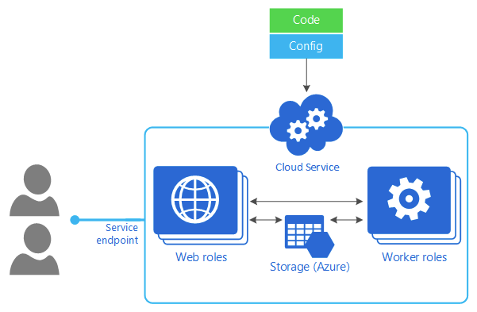
Worker Roles
Notes:
Worker Roles can be thought of the WebJobs powerlifting big brother. Worker Roles are part of the Cloud Services service, which Web Roles are part of too.
So all the features a Web Role has a Worker Role has. The difference between a Web Role and a Worker role is that Worker Roles are not hosted in IIS so cannot contain one or more web applications. A Worker Role can be thought of as Windows services that execute background tasks but in the cloud.
Unlike a WebJob a WorkerRole is hosted in its own VM, so any resource heavy tasks wont affect the Website. This also means it can scale independently of a WebApp or Web Role.

Slide 26
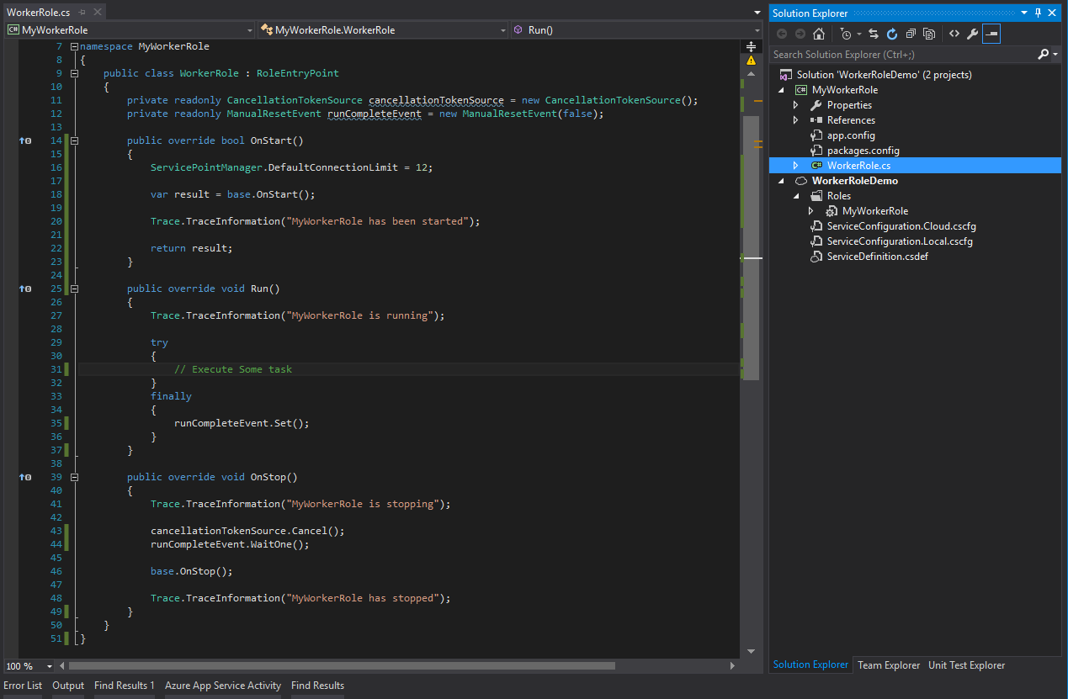
Worker Roles
Notes:
Worker Roles still has a RoleEntryPoint class and the Service Configuration project, but we don’t have the ASP.NET that we had earlier.

Slide 27
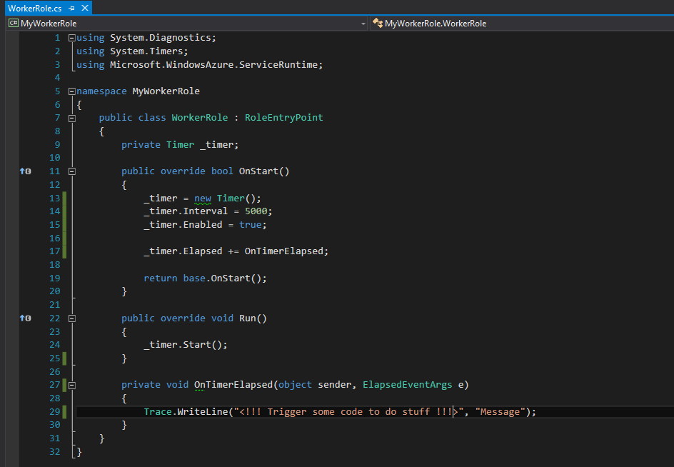
Worker Roles
Notes:
Here I have modified the class to write some text out every 5 seconds using a Timer event. It is not spectacular but it shows how the Worker Role creates and sets up the Timer in the OnStart method. Then Starts the timer in the Run method.
While both WebJobs and Worker Roles are able to process background tasks.
WebJobs can only do one thing, you would have to deploy many different WebJobs to process different tasks.
If you required additional software installed to complete a task, a Worker Role would be the only choice as you can RDP into a Worker Role but you cannot on a WebJob.
If your objective is to run scheduled jobs only using the libraries available in .Net then a WebJob would be the correct choice.
In my opinion I would start off with a WebJob as they are easy to setup and deploy. They also scale really well and are cheap. If you find in the future that WebJobs are suboptimal for whatever you are doing you can move over to a Worker Role.

